Slide 1
System Development Methods CT00046-3-2
Comparing Methodologies

Slide 2
Topic & Structure of the Lesson
Comparing Methodologies
Frameworks
Blending Methodologies

Slide 3
Learning Outcome
At the end of the module, you should able to:
The criteria needed to compare methodologies
Comparing Methodologies
Using Frameworks to compare Methodologies

Slide 4
Key Terms you must be able to use
If you have mastered this topic, you should be able to use the following terms correctly in your assignments and exams:
Comparing Methodologies
Frameworks
Blending Methodologies

Slide 5
Comparisons of Methodologies
Comparison made to select ONE (or more) suitable methodology for a project.
Wrong selection (or no Methodology) would be disastrous
Like first time cooking without a recipe.
Comparison should be made between methodologies of the same caliber.

Slide 6
Choosing the right Methodology depends on …..
The type of problems and suggested solution
Direct solution, hypothesis, anomalies, etc.
The type of project
exclusive, corporate, partnership, outsourced, etc.
Speed of the project.
The type of products
Mobile, web, stand-alone, enterprise / corporate, etc.
The expected output (conceptual, working product, etc)
Requirements are fixed or can be often changing.
Size and budget of project

Slide 7
Choosing the right Methodology depends on ….. (cont)
Knowledge of developer
Developer trained specifically under one methodology. Have enough resources for most of the process.
Developers can be easily trained on the methodology.
Vendor/partner familiar with the methodology you use.
Tools that developer have VS tools recommended by the methodology
Support for a particular methodology is easily obtained
By supporting bodies.
Experts are available.
Availability of users throughout the project.

Slide 8
Comparing Methodologies Example
Facts | Waterfall | RAD | SSM | ……
Types of Projects | Direct Solution | Direct Solution | Hypothesis
Size of Project | Large | Small to Medium | Medium to Large
Type of Product | Any | Applications | Enterprise
Support / Consultation Available | No | Yes (From Authors) | Yes (From …..)

Slide 9
Quick Quiz
What are the criteria that you would use to compare methodologies for a project?

Slide 10
Other options for choosing a suitable Methodology
Use Framework
Blend Methodologies

Slide 11
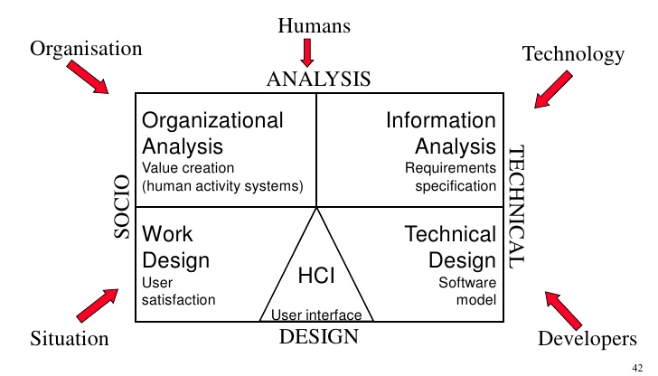
Framework
Frameworks are a systematic way of applying methodologies
It allows developers to see the system from different ‘point of view’
It shows the most efficient solutions for problems.
Example; MULTIVIEW, NIMSAD, Oracle ADF etc.

Slide 12
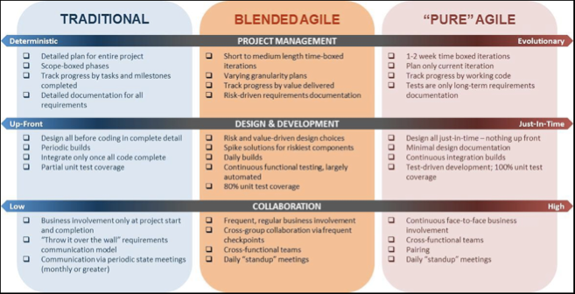

Blending Methodologies

Slide 13

Blending Methodologies
Sometimes one methodology is not sufficient for a particular project.
Project might be blended as well
Vendors are involved / part of the project has been outsourced
Blending methodology is a process of blending TWO (or more) methodologies for a project.
Vertical Blending – Blending all part of ‘A’ with all part ‘B’
Horizontal Blending – blending some part of ‘A’ with other part of ‘B’.

Slide 14
Quick Quiz
What are the advantages of blending Methodologies?

Slide 15

Conclusions on Methodologies
All Methodologies have;
Stages – steps on what to do
Techniques – Different ways (styles) of doing a task
Tools – used to effectively and efficiently carry-out a task.

Slide 16
Question & Answer

Slide 17
Next Session
System Development Planning

Slide 18
Tutorial
Scenario;
You are given a task to build a ‘Classroom Scheduling System’ for APU’s new campus. The system should be linked to the current Webspace-2.
Question;
You want to choose a suitable methodology for the particular project. Explain the criteria that you would consider for choosing it.

